Slide 1
COMPLETE
BUSINESS
STATISTICS
by
AMIR D. ACZEL
&
JAYAVEL SOUNDERPANDIAN
7th edition.
Prepared by Lloyd Jaisingh, Morehead State University
Chapter 7
Hypothesis Testing
McGraw-Hill/Irwin
Copyright © 2009 by The McGraw-Hill Companies, Inc. All rights reserved.

Slide 2
_{7-<number>}
7
Hypothesis Testing
Using Statistics
The Concept of Hypothesis Testing
Computing the p-value
The Hypothesis Test
Pre-Test Decisions

Slide 3
_{7-<number>}
7
LEARNING OBJECTIVES
After reading this chapter you should be able to:
Explain why hypothesis testing is important
Describe the role of sampling in hypothesis testing
Identify Type I and Type II errors and how they conflict with each other
Interpret the confidence level, the significance level and the power of a test
Compute and interpret p-values
Determine the sample size and significance level for a given hypothesis test
Use templates for p-value computations
Plot power curves and operating characteristic curves using templates

Slide 4
7-1: Using Statistics
_{7-<number>}
A hypothesis is a statement or assertion about the state of nature (about the true value of an unknown population parameter):
  The accused is innocent
  μ = 100
Every hypothesis implies its contradiction or alternative:
  The accused is guilty
  μ ≠100
A hypothesis is either true or false, and you may fail to reject it or you may reject it on the basis of information:
  Trial testimony and evidence
  Sample data

Slide 5
Decision-Making
_{7-<number>}
One hypothesis is maintained to be true until a decision is made to reject it as false:
  Guilt is proven “beyond a reasonable doubt”
  The alternative is highly improbable
A decision to fail to reject or reject a hypothesis may be:
  Correct
    A true hypothesis may not be rejected
      An innocent defendant may be acquitted
    A false hypothesis may be rejected
      A guilty defendant may be convicted
  Incorrect
    A true hypothesis may be rejected
      An innocent defendant may be convicted
    A false hypothesis may not be rejected
      A guilty defendant may be acquitted

Slide 6
Statistical Hypothesis Testing
_{7-<number>}
A null hypothesis, denoted by H₀, is an assertion about one or more population parameters. This is the assertion we hold to be true until we have sufficient statistical evidence to conclude otherwise.
  H₀: μ = 100
The alternative hypothesis, denoted by H₁, is the assertion of all situations not covered by the null hypothesis.
  H₁: μ ≠ 100
H₀ and H₁ are:
  Mutually exclusive
    Only one can be true.
  Exhaustive
    Together they cover all possibilities, so one or the other must be true.

Slide 7
Hypothesis about other Parameters
_{7-<number>}
Hypotheses about other parameters such as population proportions and and population variances are also possible. For example
  H₀: p ≥ 40%
  H₁: p < 40%
  H₀: σ² ≤ 50
  H₁: σ² > 50

Slide 8
The Null Hypothesis, H₀
_{7-<number>}
The null hypothesis:
  Often represents the status quo situation or an existing belief.
  Is maintained, or held to be true, until a test leads to its rejection in favor of the alternative hypothesis.
  Is accepted as true or rejected as false on the basis of a consideration of a test statistic.

Slide 9
7-2 The Concepts of Hypothesis Testing
_{7-<number>}
A test statistic is a sample statistic computed from sample data. The value of the test statistic is used in determining whether or not we may reject the null hypothesis.
The decision rule of a statistical hypothesis test is a rule that specifies the conditions under which the null hypothesis may be rejected.
Consider H₀: μ = 100. We may have a decision rule that says: “Reject H₀ if the sample mean is less than 95 or more than 105.”
In a courtroom we may say: “The accused is innocent until proven guilty beyond a reasonable doubt.”

Slide 10
Decision Making
_{7-<number>}
There are two possible states of nature:
  H₀ is true
  H₀ is false
There are two possible decisions:
  Fail to reject H₀ as true
  Reject H₀ as false

Slide 11
Decision Making
_{7-<number>}
A decision may be correct in two ways:
  Fail to reject a true H₀
  Reject a false H₀
A decision may be incorrect in two ways:
  Type I Error: Reject a true H₀
    The Probability of a Type I error is denoted by α.
  Type II Error: Fail to reject a false H₀
    The Probability of a Type II error is denoted by β.

Slide 12
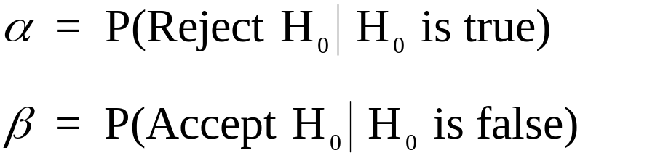
Errors in Hypothesis Testing
_{7-<number>}
A decision may be incorrect in two ways:
  Type I Error: Reject a true H₀
    The Probability of a Type I error is denoted by α.
    α is called the level of significance of the test
  Type II Error: Accept a false H₀
    The Probability of a Type II error is denoted by β.
    1 - β is called the power of the test.
α and β are conditional probabilities:

Slide 13
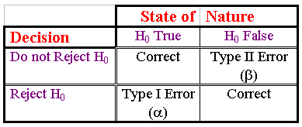
Type I and Type II Errors
_{7-<number>}
A contingency table illustrates the possible outcomes of a statistical hypothesis test.

Slide 14
The p-Value
_{7-<number>}
The p-value is the probability of obtaining a value of the test statistic as extreme as, or more extreme than, the actual value obtained, when the null hypothesis is true.
The p-value is the smallest level of significance, α, at which the null hypothesis may be rejected using the obtained value of the test statistic.
RULE: When the p-value is less than α , reject H₀.
NOTE: More detailed discussions about the p-value will be given later in the chapter when examples on hypothesis tests are presented.

Slide 15
The Power of a Test
_{7-<number>}
The power of a statistical hypothesis test is the probability of rejecting the null hypothesis when the null hypothesis is false.
Power = (1 - β)

Slide 16
The Power Function
_{7-<number>}
The probability of a type II error, and the power of a test, depends on the actual value of the unknown population parameter. The relationship between the population mean and the power of the test is called the power function.
Value of μβ Power = (1 - β)
61 0.8739 0.1261
62 0.7405 0.2695
63 0.5577 0.4423
64 0.3613 0.6387
65 0.1963 0.8037
66 0.0877 0.9123
67 0.0318 0.9682
68 0.0092 0.9908
69 0.0021 0.9972
P
o
w
e
r
o
f
a
O
n
e
-
T
a
i
l
e
d
T
e
s
t
:
μ
=
6
0
,
α
=
0
.
0
5
1
.
0
0
.
9
0
.
8
0
.
7
Power
0
.
6
0
.
5
0
.
4
0
.
3
0
.
α=0.05
2
0
.
1
0
.
0
μ
6
0
6
1
6
2
6
3
6
4
6
5
6
6
6
7
6
8
6
9
7
0

Slide 17
Factors Affecting the Power Function
_{7-<number>}
The power depends on the distance between the value of the parameter under the null hypothesis and the true value of the parameter in question: the greater this distance, the greater the power.
The power depends on the population standard deviation: the smaller the population standard deviation, the greater the power.
The power depends on the sample size used: the larger the sample, the greater the power.
The power depends on the level of significance of the test: the smaller the level of significance,α , the smaller the power.

Slide 18
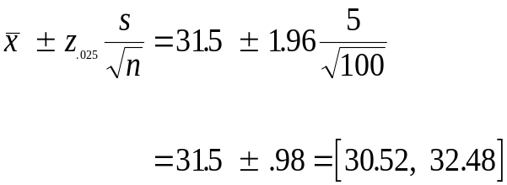
Example
_{7-<number>}
A company that delivers packages within a large metropolitan area claims that it takes an average of 28 minutes for a package to be delivered from your door to the destination. Suppose that you want to carry out a hypothesis test of this claim.
Set the null and alternative hypotheses:
H₀: μ = 28
H₁: μ ≠ 28
Collect sample data:
n = 100
x = 31.5
s = 5
Construct a 95% confidence interval for
the average delivery times of all packages:
We can be 95% sure that the average time for all packages is between 30.52 and 32.48 minutes.
Since the asserted value, 28 minutes, is not in this 95% confidence interval, we may reasonably reject the null hypothesis.

Slide 19
7-3 Computing the p-Value
_{7-<number>}
Recall:
The p-value is the probability of obtaining a value of the test statistic as extreme as, or more extreme than, the actual value obtained, when the null hypothesis is true.
The p-value is the smallest level of significance, α, at which the null hypothesis may be rejected using the obtained value of the test statistic.

Slide 20
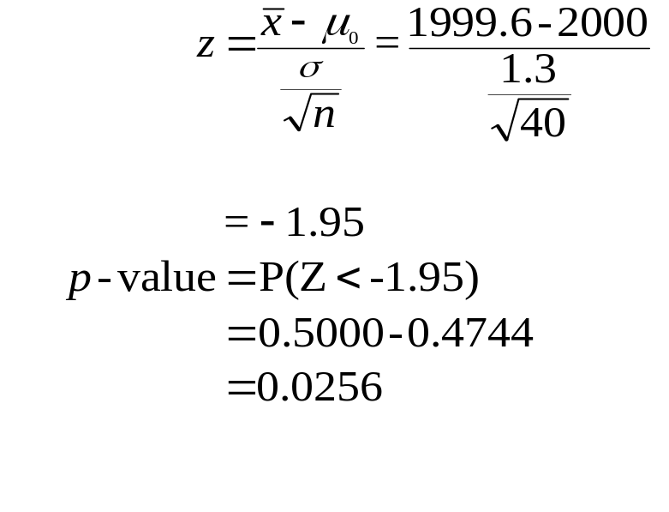
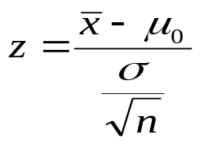
Example
_{7-<number>}
An automatic bottling machine fills cola into two liter (2000 cc) bottles. A consumer advocate wants to test the null hypothesis that the average amount filled by the machine into a bottle is at least 2000 cc. A random sample of 40 bottles coming out of the machine was selected and the exact content of the selected bottles are recorded. The sample mean was 1999.6 cc. The population standard deviation is known from past experience to be 1.30 cc.
Compute the p-value for this test.
H₀: μ ≥ 2000
H₁: μ < 2000
n = 40, μ₀ = 2000, x-bar = 1999.6, σ = 1.3
The test statistic is:

Slide 21
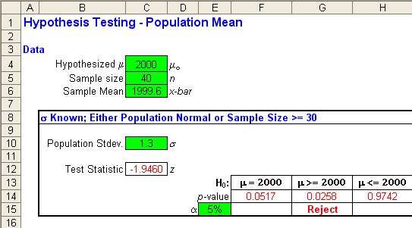
Example – Using Excel Template
_{7-<number>}
An automatic bottling machine fills cola into two liter (2000 cc) bottles. A consumer advocate wants to test the null hypothesis that the average amount filled by the machine into a bottle is at least 2000 cc. A random sample of 40 bottles coming out of the machine was selected and the exact content of the selected bottles are recorded. The sample mean was 1999.6 cc. The population standard deviation is known from past experience to be 1.30 cc.
Compute the p-value for this test.

Slide 22
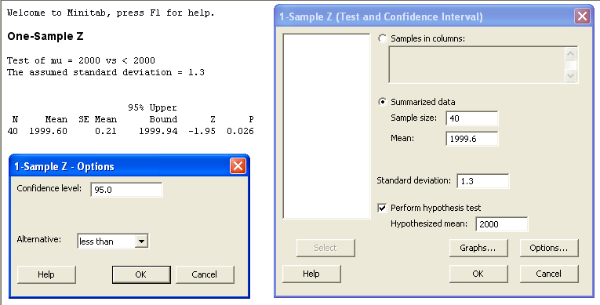
Example (continued) – Using Minitab
_{7-<number>}
P-value

Slide 23
1-Tailed and 2-Tailed Tests
_{7-<number>}
The tails of a statistical test are determined by the need for an action. If action is to be taken if a parameter is greater than some value a, then the alternative hypothesis is that the parameter is greater than a, and the test is a right-tailed test. H₀: μ ≤ 50
H₁: μ > 50
If action is to be taken if a parameter is less than some value a, then the alternative hypothesis is that the parameter is less than a, and the test is a left-tailed test. H₀: μ ≥ 50
H₁: μ < 50
If action is to be taken if a parameter is either greater than or less than some value a, then the alternative hypothesis is that the parameter is not equal to a, and the test is a two-tailed test. H₀: μ = 50
H₁: μ ≠ 50

Slide 24
Computing β (for a left-tailed test)
_{7-<number>}
Consider the following null and alternative hypotheses:
H₀: μ ≥ 1000
H₁: μ < 1000
Let σ = 5, α = 5%, and n = 100. We wish to compute β when μ = μ₁ = 998.
Refer to next slide
The figure shows the distribution of x-bar when μ = μ₀ = 1000, and when
μ = μ₁ = 998.
Note that H₀ will be rejected when x-bar is less than the critical value given
by (x-bar)_{crit} = μ₀ -z_{α} ∗ σ/√n = 1000 – 1.645∗5/ √100 = 999.18.
Conversely, H₀ will not be rejected whenever x-bar is greater than (x-bar)_{crit}.

Slide 25
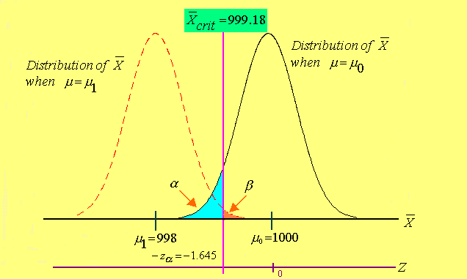
Computing β (continued)
_{7-<number>}

Slide 26
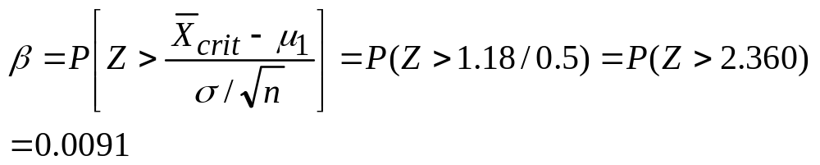
Computing β (continued)
_{7-<number>}
When μ = μ₁ = 998, β will be the probability of not rejecting H₀ which
implies that P{(x-bar > (x-bar)_{crit}}.
When μ = μ₁, x-bar will follow a normal distribution with mean μ₁ and
standard deviation = σ/√n. Thus,
The power of the test = 1 – 0.0091 = 0.9909.

Slide 27
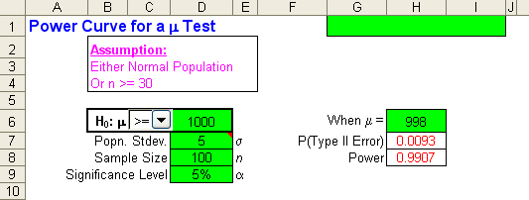
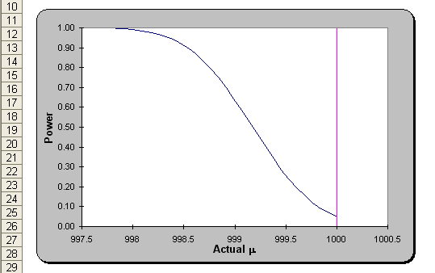
Computing β (continued) – Using Excel
_{7-<number>}

Slide 28
7-4 The Hypothesis Test
_{7-<number>}
We will see the three different types of hypothesis tests, namely
Tests of hypotheses about population means.
Tests of hypotheses about population proportions.
Tests of hypotheses about population variances.

Slide 29
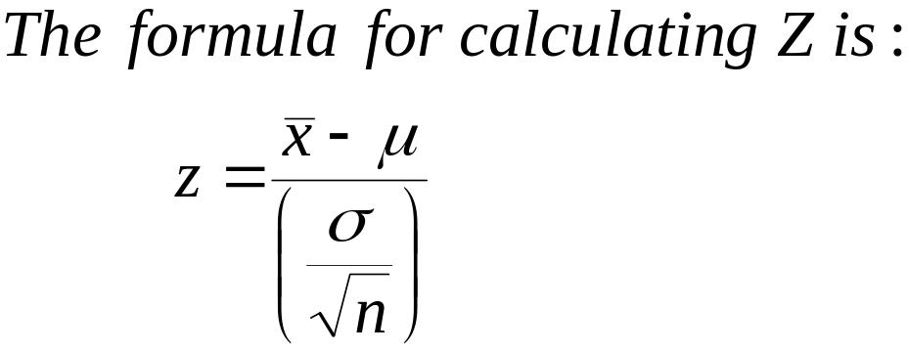
Testing Population Means
_{7-<number>}
Cases in which the test statistic is Z
σ is known and the population is normal.
σ is known and the sample size is at least 30. (The population need not be normal)

Slide 30
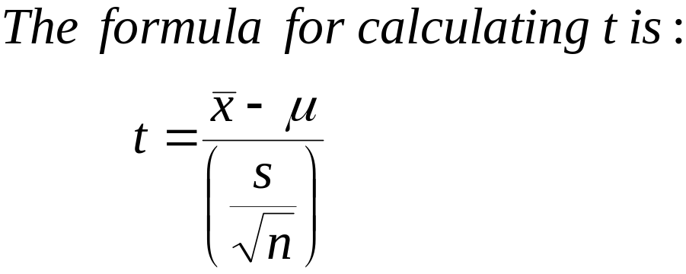
Testing Population Means
_{7-<number>}
Cases in which the test statistic is t
σ is unknown but the sample standard deviation is known and the population is normal.

Slide 31
Rejection Region
_{7-<number>}
The rejection region of a statistical hypothesis test is the range of numbers that will lead us to reject the null hypothesis in case the test statistic falls within this range. The rejection region, also called the critical region, is defined by the critical points. The rejection region is defined so that, before the sampling takes place, our test statistic will have a probability α of falling within the rejection region if the null hypothesis is true.

Slide 32
Nonrejection Region
_{7-<number>}
The nonrejection region is the range of values (also determined by the critical points) that will lead us not to reject the null hypothesis if the test statistic should fall within this region. The nonrejection region is designed so that, before the sampling takes place, our test statistic will have a probability 1-α of falling within the nonrejection region if the null hypothesis is true
  In a two-tailed test, the rejection region consists of the values in both tails of the sampling distribution.

Slide 33
Picturing Hypothesis Testing
_{7-<number>}
95% confidence interval around observed sample mean
Population mean under H₀
μ = 28
30.52
x = 31.5
32.48
It seems reasonable to reject the null hypothesis, H₀: μ = 28, since the hypothesized value lies outside the 95% confidence interval. If we are 95% sure that the population mean is between 30.52 and 32.58 minutes, it is very unlikely that the population mean will actually be 28 minutes.
Note that the population mean may be 28 (the null hypothesis might be true), but then the observed sample mean, 31.5, would be a very unlikely occurrence. There is still the small chance (α = 0.05) that we might reject the true null hypothesis.
α represents the level of significance of the test.

Slide 34
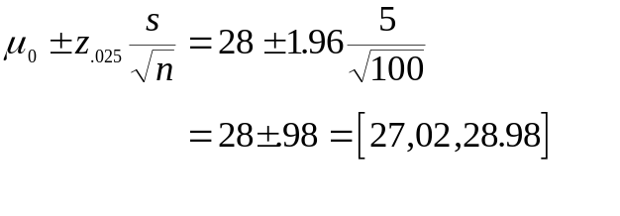
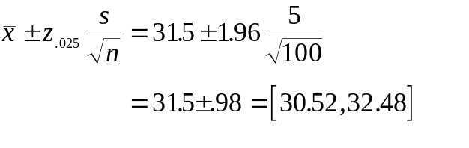
Nonrejection Region
_{7-<number>}
If the observed sample mean falls within the nonrejection region, then you fail to reject the null hypothesis as true. Construct a 95% nonrejection region around the hypothesized population mean, and compare it with the 95% confidence interval around the observed sample mean:
95% non- rejection region around the population Mean
95% Confidence Interval
around the Sample Mean
27.02
μ₀=28
28.98
30.52
x=31.5
32.48
The nonrejection region and the confidence interval are the same width, but centered on different points. In this instance, the nonrejection region does not include the observed sample mean, and the confidence interval does not include the hypothesized population mean.

Slide 35
Picturing the Nonrejection and Rejection Regions
_{7-<number>}
T
h
e
H
y
p
o
t
h
e
s
i
z
e
d
S
a
m
p
l
i
n
g
D
i
s
t
r
i
b
u
t
i
o
n
o
f
t
h
e
M
e
a
If the null hypothesis were true, then the sampling distribution of the mean would look something
like this:
n
0
.
8
0
.
7
.95
0
.
6
0
.
5
0
.
4
0
.
3
0
.025
.025
.
2
0
.
1
We will find 95% of the
sampling distribution between
the critical points 27.02 and 28.98,
and 2.5% below 27.02 and 2.5% above 28.98 (a two-tailed test). The 95% interval around the hypothesized mean defines the nonrejection region, with the remaining 5% in two rejection regions.
0
.
0
27.02
μ₀=28
28.98

Slide 36
The Decision Rule
_{7-<number>}
T
h
e
H
y
p
o
t
h
e
s
i
z
e
d
S
a
m
p
l
i
n
g
D
i
s
t
r
i
b
u
t
i
o
n
o
f
t
h
e
M
e
a
n
0
.
8
0
.
7
.95
0
.
6
0
.
5
0
.
4
0
.
3
.025
.025
0
.
2
0
.
1
0
.
0
27.02
μ₀=28
28.98
x=31.5
Lower Rejection
Region
Nonrejection
Region
Upper Rejection
Region
Construct a (1-α) nonrejection region around the hypothesized population mean.
  Do not reject H₀ if the sample mean falls within the nonrejection region (between the critical points).
  Reject H₀ if the sample mean falls outside the nonrejection region.

Slide 37
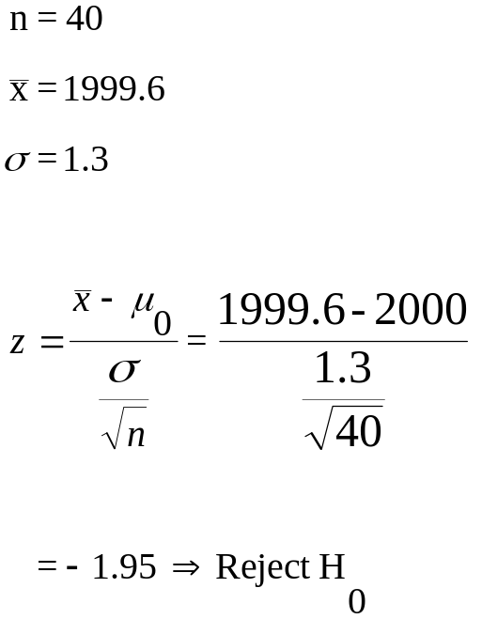
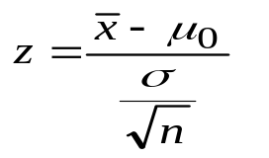
Example 7-5
_{7-<number>}
An automatic bottling machine fills cola into two liter (2000 cc) bottles. A consumer advocate wants to test the null hypothesis that the average amount filled by the machine into a bottle is at least 2000 cc. A random sample of 40 bottles coming out of the machine was selected and the exact content of the selected bottles are recorded. The sample mean was 1999.6 cc. The population standard deviation is known from past experience to be 1.30 cc.
Test the null hypothesis at the 5% significance level.
H₀: μ ≥ 2000
H₁: μ < 2000
n = 40
For α = 0.05, the critical value
of z is -1.645
The test statistic is:
Do not reject H₀ if: [z ≥-1.645]
Reject H₀ if: [z <−1.645]

Slide 38
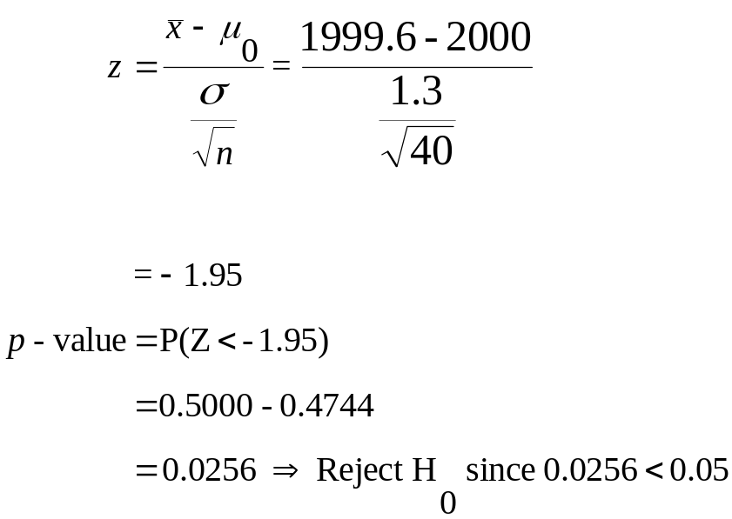
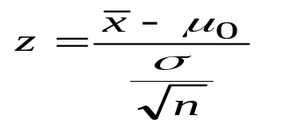
Example 7-5: p-value approach
_{7-<number>}
An automatic bottling machine fills cola into two liter (2000 cc) bottles. A consumer advocate wants to test the null hypothesis that the average amount filled by the machine into a bottle is at least 2000 cc. A random sample of 40 bottles coming out of the machine was selected and the exact content of the selected bottles are recorded. The sample mean was 1999.6 cc. The population standard deviation is known from past experience to be 1.30 cc.
Test the null hypothesis at the 5% significance level.
H₀: μ ≥ 2000
H₁: μ < 2000
n = 40
For α = 0.05, the critical value
of z is -1.645
The test statistic is:
Do not reject H₀ if: [p-value ≥ 0.05]
Reject H₀ if: [p-value <0.05]

Slide 39
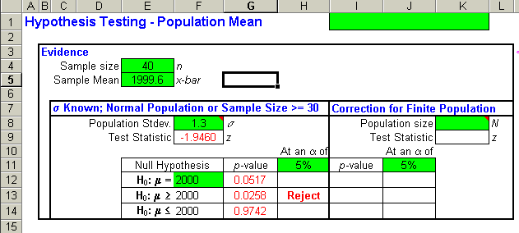
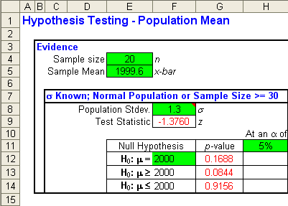
Example 7-5: Using the Template
_{7-<number>}
n = 40
Observe that the decision about
the null hypothesis changed when the
sample size changed from 40 to 20.
n = 20

Slide 40
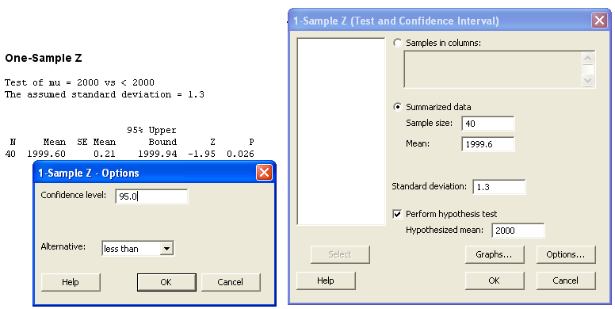
Example 7-5: Using Minitab with n = 40
_{7-<number>}
P-value

Slide 41
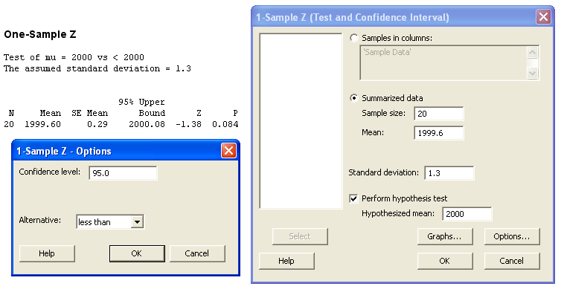
Example 7-5: Using Minitab with n = 20
_{7-<number>}
P-value

Slide 42
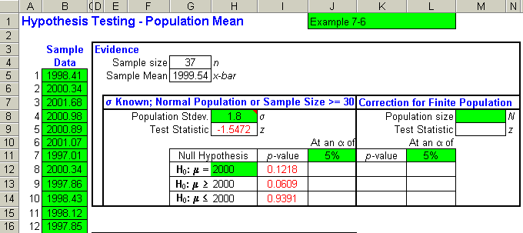
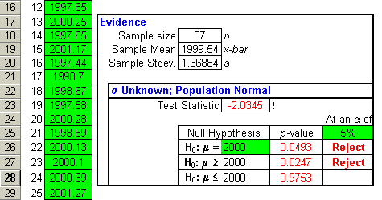
Example 7-6: Using the Template with Sample Data
_{7-<number>}
Results when
σ is known
Results when σ is unknown
Observe that the decision about
the null hypothesis changed when the population standard deviation is known or unknown.

Slide 43
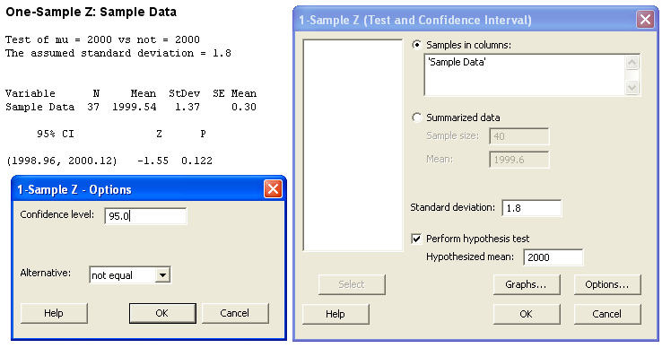
Example 7-6: Using Minitab with Sample Data and σ = 1.8
_{7-<number>}
P-value

Slide 44
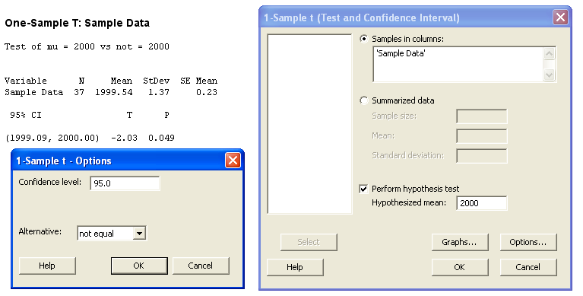
Example 7-6: Using Minitab with Sample Data with σ unknown
_{7-<number>}
P-value

Slide 45
Testing Population Proportions
_{7-<number>}
Cases in which the binomial distribution can be used
The binomial distribution can be used whenever we are able to calculate the necessary binomial probabilities. This means that for calculations using tables, the sample size n and the population proportion p should have been tabulated.
Note: For calculations using spreadsheet templates, sample sizes up to 500 are feasible.

Slide 46
Testing Population Proportions
_{7-<number>}
Cases in which the normal approximation is to be used
If the sample size n is too large (n > 500) to calculate binomial probabilities, then the normal approximation can be used, and the population proportion p should have been tabulated.

Slide 47
Example 7-7: p-value approach
_{7-<number>}
A coin is to tested for fairness. It is tossed 25 times and only 8 Heads are observed. Test if the coin is fair at an α of 5% (significance level).
Let p denote the probability of a Head
H₀: p = 0.5
H₁: p ≠ 0.5
Because this is a 2-tailed test, the p-value = 2*P(X ≤ 8)
From the binomial tables, with n = 25, p = 0.5, this value
2*0.054 = 0.108.
Since 0.108 > α = 0.05, then
do not reject H₀

Slide 48
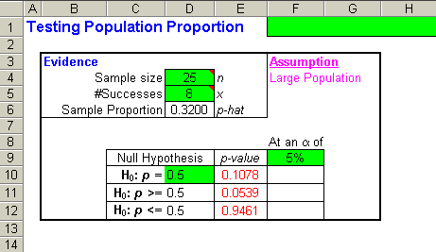
Example 7-7: Using the Template with the Binomial Distribution
_{7-<number>}

Slide 49
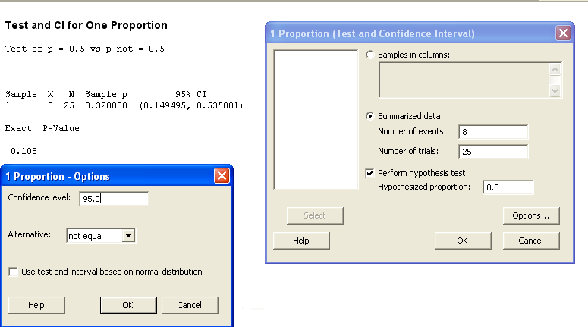
Example 7-7: Using MINITAB without Normal Approximation
_{7-<number>}

Slide 50
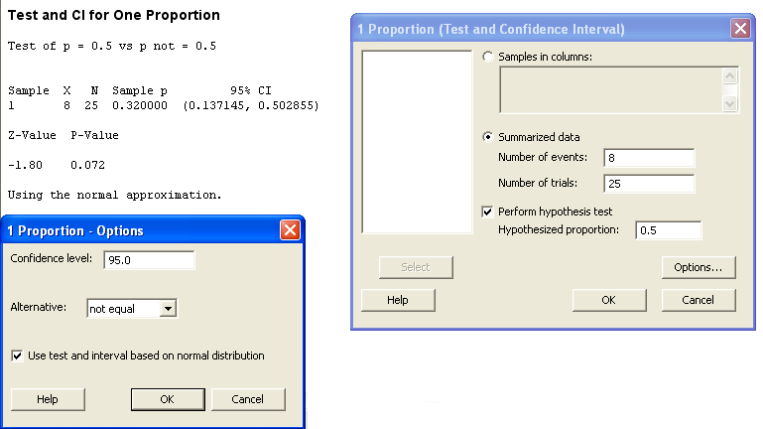
Example 7-7: Using MINITAB with Normal Approximation
_{7-<number>}
NOTE: The p-value given by Minitab is different
from the previous slide because we used the
normal approximation.

Slide 51
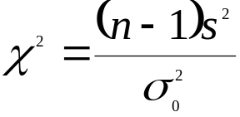

Testing Population Variances
_{7-<number>}
For testing hypotheses about population variances, the test statistic (chi-square) is:
where is the claimed value of the population variance in the null hypothesis. The degrees of freedom for this chi-square random variable is (n – 1).
Note: Since the chi-square table only provides the critical values, it cannot be used to calculate exact p-values. As in the case of the t-tables, only a range of possible values can be inferred.

Slide 52
Example 7-8
_{7-<number>}
A manufacturer of golf balls claims that they control the weights of the golf balls accurately so that the variance of the weights is not more than 1 mg². A random sample of 31 golf balls yields a sample variance of 1.62 mg². Is that sufficient evidence to reject the claim at an α of 5%?
Let σ² denote the population variance. Then
H₀: σ² < 1
H₁: σ² > 1
In the template (see next slide), enter 31 for the sample size
and 1.62 for the sample variance. Enter the hypothesized value
of 1 in cell D11. The p-value of 0.0173 appears in cell E13. Since
this value is less than the α of 5%, we reject the null hypothesis.

Slide 53
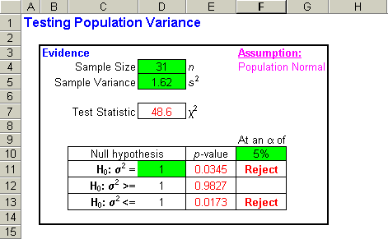
Example 7-8 – Using the Template
_{7-<number>}
Decision is to reject the null hypothesis.

Slide 54
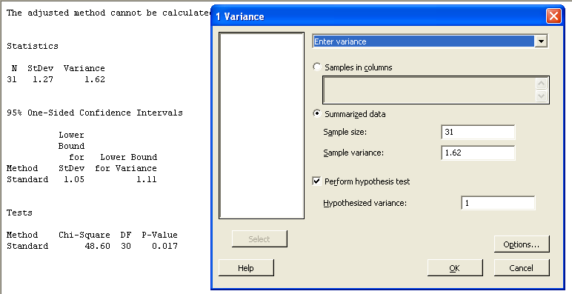
Example 7-8 – Using Minitab
_{7-<number>}
P- value

Slide 55
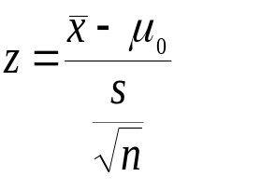
Additional Examples (a)
_{7-<number>}
As part of a survey to determine the extent of required in-cabin storage capacity, a researcher needs to test the null hypothesis that the average weight of carry-on baggage per person is μ ₀ = 12 pounds, versus the alternative hypothesis that the average weight is not 12 pounds. The analyst wants to test the null hypothesis at α = 0.05.
H₀: μ = 12
H₁: μ ≠ 12
For α = 0.05, critical values of z are ±1.96
The test statistic is:
Do not reject H₀ if: [-1.96 ≤ z ≤1.96]
Reject H₀ if: [z <-1.96] or [z >1.96]
The Standard Normal Distribution
0
.
8
0
.
7
.95
0
.
6
0
.
5
0
.
4
0
.
3
.025
.025
0
.
2
0
.
1
0
.
0
-1.96
0
1.96
z
Lower Rejection
Region
Nonrejection
Region
Upper Rejection
Region

Slide 56
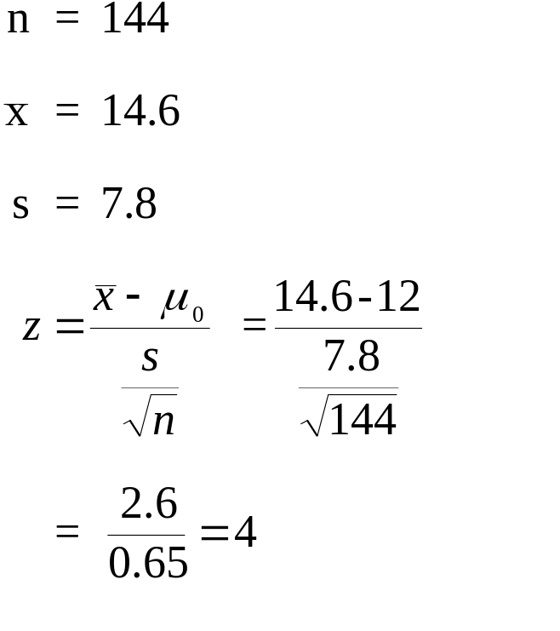
Additional Examples (a): Solution
_{7-<number>}
The Standard Normal Distribution
0
.
8
0
.
7
.95
0
.
6
0
.
5
0
.
4
0
.
3
.025
.025
0
.
2
0
.
1
0
.
0
-1.96
0
1.96
z
4
Lower Rejection
Region
Nonrejection
Region
Upper Rejection
Region
Since the test statistic falls in the upper rejection region, H₀ is rejected, and we may conclude that the average amount of carry-on baggage is more than 12 pounds.

Slide 57
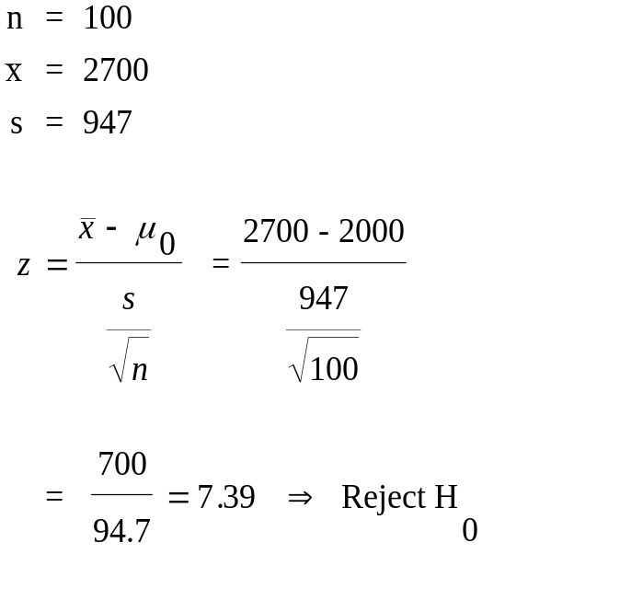
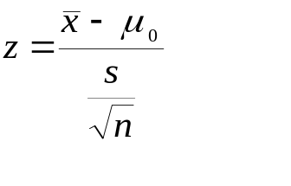
Additional Examples (b)
_{7-<number>}
An insurance company believes that, over the last few years, the average liability insurance per board seat in companies defined as “small companies” has been $2000. Using α = 0.01, test this hypothesis using Growth Resources, Inc. survey data.
H₀: μ = 2000
H₁: μ ≠ 2000
For α = 0.01, critical values of z are ±2.576
The test statistic is:
Do not reject H₀ if: [-2.576 ≤ z ≤ 2.576]
Reject H₀ if: [z <-2.576] or [z >2.576]

Slide 58
Additional Examples (b) : Continued
_{7-<number>}
The Standard Normal Distribution
Since the test statistic falls in the upper rejection region, H₀ is rejected, and we may conclude that the average insurance liability per board seat in “small companies” is more than $2000.
0
.
8
0
.
7
.99
0
.
6
0
.
5
0
.
4
0
.
3
.005
.005
0
.
2
0
.
1
0
.
0
-2.576
0
2.576
z
7.39
Lower Rejection
Region
Nonrejection
Region
Upper Rejection
Region

Slide 59
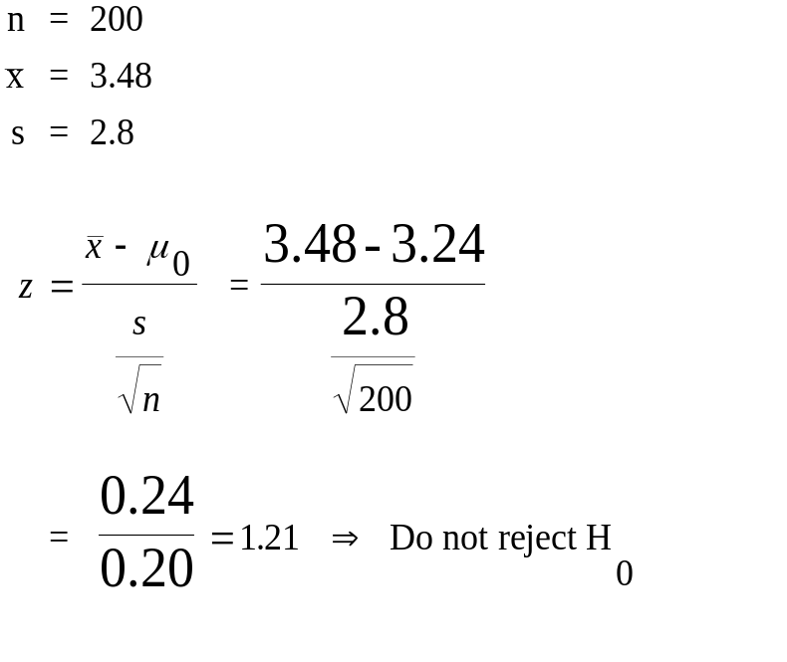
Additional Examples (c)
_{7-<number>}
The average time it takes a computer to perform a certain task is believed to be 3.24 seconds. It was decided to test the statistical hypothesis that the average performance time of the task using the new algorithm is the same, against the alternative that the average performance time is no longer the same, at the 0.05 level of significance.
H₀: μ = 3.24
H₁: μ ≠ 3.24
For α = 0.05, critical values of z are ±1.96
The test statistic is:
Do not reject H₀ if: [-1.96 ≤ z ≤1.96]
Reject H₀ if: [z < -1.96] or [z >1.96]

Slide 60
Additional Examples (c) : Continued
_{7-<number>}
The Standard Normal Distribution
Since the test statistic falls in the nonrejection region, H₀ is not rejected, and we may conclude that the average performance time has not changed from 3.24 seconds.
0
.
8
0
.
7
.95
0
.
6
0
.
5
0
.
4
0
.
3
.025
.025
0
.
2
0
.
1
0
.
0
-1.96
0
1.96
z
1.21
Lower Rejection
Region
Nonrejection
Region
Upper Rejection
Region

Slide 61
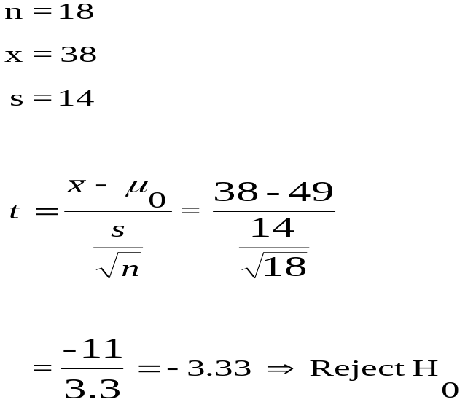
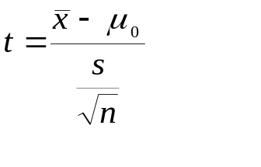
Additional Examples (d)
_{7-<number>}
According to the Japanese National Land Agency, average land prices in central Tokyo soared 49% in the first six months of 1995. An international real estate investment company wants to test this claim against the alternative that the average price did not rise by 49%, at a 0.01 level of significance.
H₀: μ = 49
H₁: μ ≠ 49
n = 18
For α = 0.01 and (18-1) = 17 df ,
critical values of t are ±2.898
The test statistic is:
Do not reject H₀ if: [-2.898 ≤ t ≤ 2.898]
Reject H₀ if: [t < -2.898] or [t > 2.898]

Slide 62
Additional Examples (d) : Continued
_{7-<number>}
The t Distribution
Since the test statistic falls in the rejection region, H₀ is rejected, and we may conclude that the average price has not risen by 49%. Since the test statistic is in the lower rejection region, we may conclude that the average price has risen by less than 49%.
0
.
8
0
.
7
.99
0
.
6
0
.
5
0
.
4
0
.
3
.005
.005
0
.
2
0
.
1
0
.
0
-2.898
0
2.898
t
−3.33
Lower Rejection
Region
Nonrejection
Region
Upper Rejection
Region

Slide 63
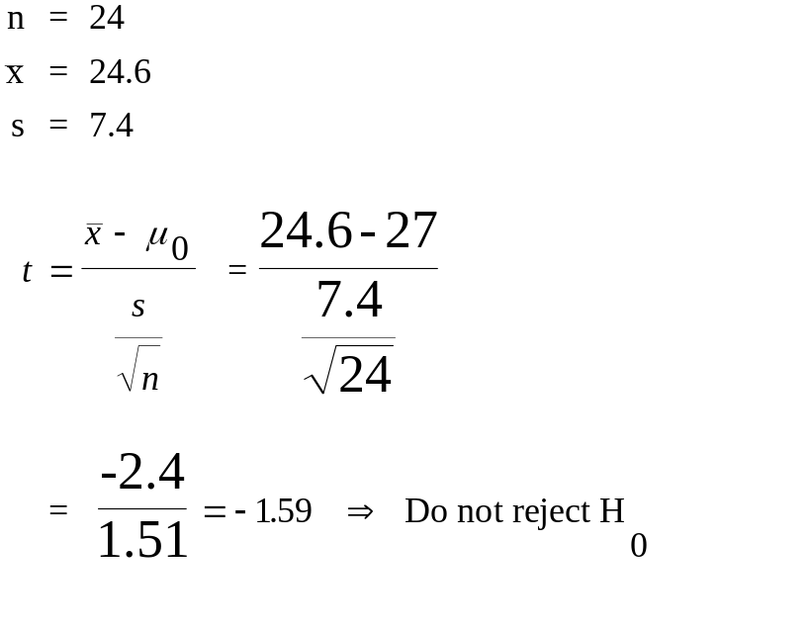
Additional Examples (e)
_{7-<number>}
Canon, Inc,. has introduced a copying machine that features two-color copying capability in a compact system copier. The average speed of the standard compact system copier is 27 copies per minute. Suppose the company wants to test whether the new copier has the same average speed as its standard compact copier. Conduct a test at an α = 0.05 level of significance.
H₀: μ = 27
H₁: μ ≠ 27
n = 24
For α = 0.05 and (24-1) = 23 df ,
critical values of t are ±2.069
The test statistic is:
Do not reject H₀ if: [-2.069 ≤ t ≤ 2.069]
Reject H₀ if: [t < -2.069] or [t > 2.069]

Slide 64
Additional Examples (e) : Continued
_{7-<number>}
The t Distribution
Since the test statistic falls in the nonrejection region, H₀ is not rejected, and we may not conclude that the average speed is different from 27 copies per minute.
0
.
8
0
.
7
.95
0
.
6
0
.
5
0
.
4
0
.
3
.025
.025
0
.
2
0
.
1
0
.
0
-2.069
0
2.069
t
−1.59
Lower Rejection
Region
Nonrejection
Region
Upper Rejection
Region

Slide 65
Statistical Significance
_{7-<number>}
While the null hypothesis is maintained to be true throughout a hypothesis test, until sample data lead to a rejection, the aim of a hypothesis test is often to disprove the null hypothesis in favor of the alternative hypothesis. This is because we can determine and regulate α, the probability of a Type I error, making it as small as we desire, such as 0.01 or 0.05. Thus, when we reject a null hypothesis, we have a high level of confidence in our decision, since we know there is a small probability that we have made an error.
A given sample mean will not lead to a rejection of a null hypothesis unless it lies in outside the nonrejection region of the test. That is, the nonrejection region includes all sample means that are not significantly different, in a statistical sense, from the hypothesized mean. The rejection regions, in turn, define the values of sample means that are significantly different, in a statistical sense, from the hypothesized mean.

Slide 66
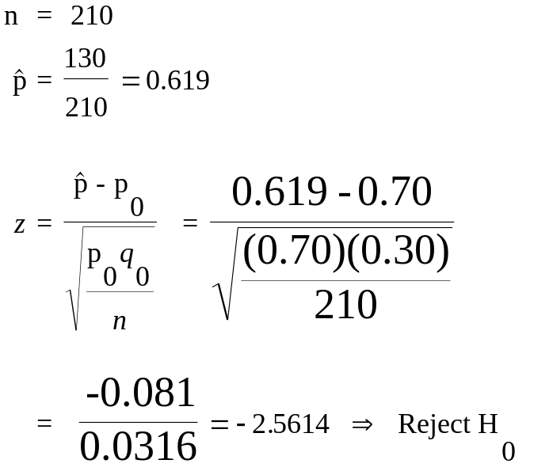
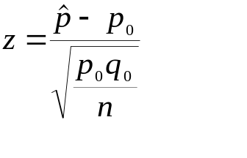
Additional Examples (f)
_{7-<number>}
An investment analyst for Goldman Sachs and Company wanted to test the hypothesis made by British securities experts that 70% of all foreign investors in the British market were American. The analyst gathered a random sample of 210 accounts of foreign investors in London and found that 130 were owned by U.S. citizens. At the α = 0.05 level of significance, is there evidence to reject the claim of the British securities experts?
H₀: p = 0.70
H₁: p ≠ 0.70
n = 210
For α = 0.05 critical values of z are ±1.96
The test statistic is:
Do not reject H₀ if: [-1.96 ≤ z ≤ 1.96]
Reject H₀ if: [z < -1.96] or [z > 1.96]

Slide 67
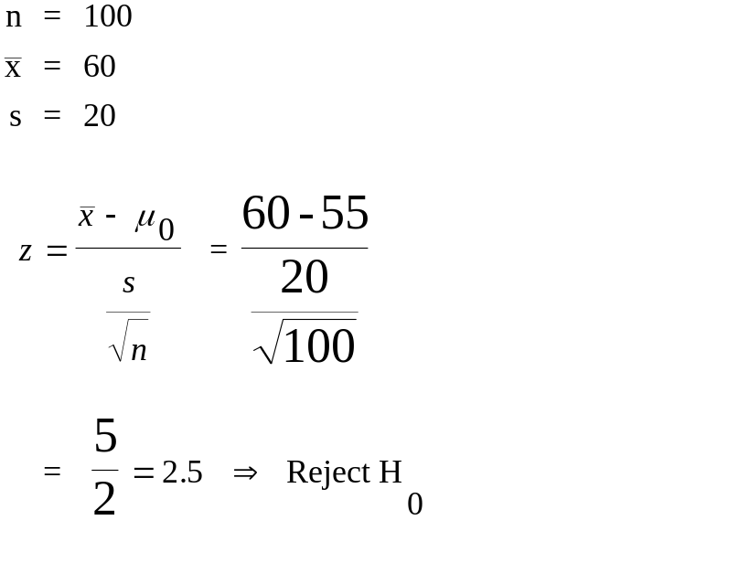

Additional Examples (g)
_{7-<number>}
The EPA sets limits on the concentrations of pollutants emitted by various industries. Suppose that the upper allowable limit on the emission of vinyl chloride is set at an average of 55 ppm within a range of two miles around the plant emitting this chemical. To check compliance with this rule, the EPA collects a random sample of 100 readings at different times and dates within the two-mile range around the plant. The findings are that the sample average concentration is 60 ppm and the sample standard deviation is 20 ppm. Is there evidence to conclude that the plant in question is violating the law?
H₀: μ ≤ 55
H₁: μ >55
n = 100
For α = 0.01, the critical value
of z is 2.326
The test statistic is:
Do not reject H₀ if: [z ≤ 2.326]
Reject H₀ if: [z >2.326]

Slide 68
Additional Examples (g) : Continued
_{7-<number>}
Critical Point for a Right-Tailed Test
Since the test statistic falls in the rejection region, H₀ is rejected, and we may conclude that the average concentration of vinyl chloride is more than 55 ppm.
0
.
4
0
0.99
.
3
f(z)
0
.
2
0
0.01
.
1
0
.
0
-
5
0
2.326
5
z
2.5
Nonrejection
Region
Rejection
Region

Slide 69
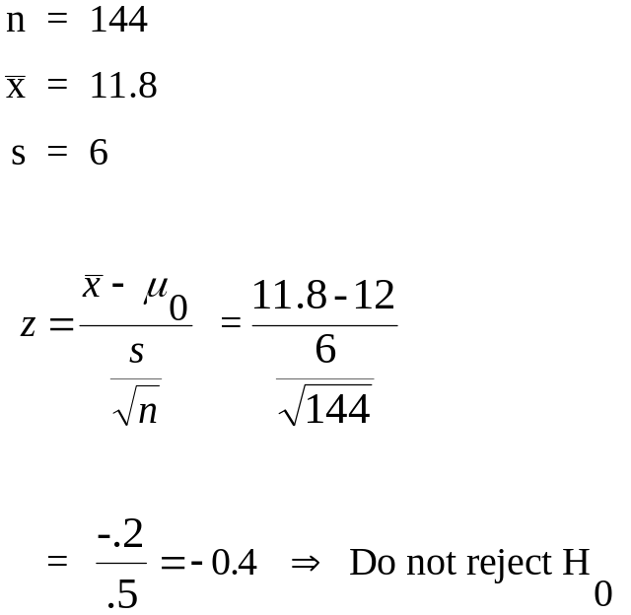
Additional Examples (h)
_{7-<number>}
A certain kind of packaged food bears the following statement on the package: “Average net weight 12 oz.” Suppose that a consumer group has been receiving complaints from users of the product who believe that they are getting smaller quantities than the manufacturer states on the package. The consumer group wants, therefore, to test the hypothesis that the average net weight of the product in question is 12 oz. versus the alternative that the packages are, on average, underfilled. A random sample of 144 packages of the food product is collected, and it is found that the average net weight in the sample is 11.8 oz. and the sample standard deviation is 6 oz. Given these findings, is there evidence the manufacturer is underfilling the packages?
H₀: μ ≥ 12
H₁: μ < 12
n = 144
For α = 0.05, the critical value
of z is -1.645
The test statistic is:
Do not reject H₀ if: [z ≥-1.645]
Reject H₀ if: [z <−1.645]

Slide 70
Additional Examples (h) : Continued
_{7-<number>}
Critical Point for a Left-Tailed Test
Since the test statistic falls in the nonrejection region, H₀ is not rejected, and we may not conclude that the manufacturer is underfilling packages on average.
0
.
4
0
0.95
.
3
f(z)
0
.
2
0.05
0
.
1
0
.
0
-
5
-1.645
0
5
z
-0.4
Rejection
Region
Nonrejection
Region

Slide 71
Additional Examples (i)
_{7-<number>}
A floodlight is said to last an average of 65 hours. A competitor believes that the average life of the floodlight is less than that stated by the manufacturer and sets out to prove that the manufacturer’s claim is false. A random sample of 21 floodlight elements is chosen and shows that the sample average is 62.5 hours and the sample standard deviation is 3. Using α=0.01, determine whether there is evidence to conclude that the manufacturer’s claim is false.
H₀: μ ≥ 65
H₁: μ < 65
n = 21
For α = 0.01 an (21-1) = 20 df, the
critical value -2.528
The test statistic is:
Do not reject H₀ if: [t ≥-2.528]
Reject H₀ if: [z < −2.528]

Slide 72
Additional Examples (i) : Continued
_{7-<number>}
Critical Point for a Left-Tailed Test
Since the test statistic falls in the rejection region, H₀ is rejected, and we may conclude that the manufacturer’s claim is false, that the average floodlight life is less than 65 hours.
0
.
4
0
0.95
.
3
f(t)
0
.
2
0.05
0
.
1
0
.
0
-
5
-2.528
0
5
t
-3.82
Rejection
Region
Nonrejection
Region

Slide 73
Additional Examples (j)
_{7-<number>}
“After looking at 1349 hotels nationwide, we’ve found 13 that meet our standards.” This statement by the Small Luxury Hotels Association implies that the proportion of all hotels in the United States that meet the association’s standards is 13/1349=0.0096. The management of a hotel that was denied acceptance to the association wanted to prove that the standards are not as stringent as claimed and that, in fact, the proportion of all hotels in the United States that would qualify is higher than 0.0096. The management hired an independent research agency, which visited a random sample of 600 hotels nationwide and found that 7 of them satisfied the exact standards set by the association. Is there evidence to conclude that the population proportion of all hotels in the country satisfying the standards set by the Small Luxury hotels Association is greater than 0.0096?
H₀: p ≤ 0.0096
H₁: p > 0.0096
n = 600
For α = 0.10 the critical value 1.282
The test statistic is:
Do not reject H₀ if: [z ≤1.282]
Reject H₀ if: [z >1.282]

Slide 74
Additional Examples (j) : Continued
_{7-<number>}
Critical Point for a Right-Tailed Test
Since the test statistic falls in the nonrejection region, H₀ is not rejected, and we may not conclude that proportion of all hotels in the country that meet the association’s standards is greater than 0.0096.
0
.
4
0
0.90
.
3
f(z)
0
.
2
0
0.10
.
1
0
.
0
-
5
0
1.282
5
z
0.519
Nonrejection
Region
Rejection
Region
NOTE: Examples (a) through (j) can be solved using
MINITAB or the EXCEL templates.

Slide 75
The p-Value Revisited
_{7-<number>}
S
t
a
n
d
a
r
d
N
o
r
m
a
l
D
i
s
t
r
i
b
u
t
i
o
n
S
t
a
n
d
a
r
d
N
o
r
m
a
l
D
i
s
t
r
i
b
u
t
i
o
n
0
.
4
0
.
4
p-value=area to
right of the test statistic
=0.3018
p-value=area to
right of the test statistic
=0.0062
0
.
3
0
.
3
)
)
z
z
(
0
(
.
2
0
.
f
2
f
0
.
1
0
.
1
0
.
0
0
.
0
-
5
0
5
-
0.519
z
5
0
2.5
5
z
Additional Example k
Additional Example g
The p-value is the probability of obtaining a value of the test statistic as extreme as, or more extreme than, the actual value obtained, when the null hypothesis is true.
The p-value is the smallest level of significance, α, at which the null hypothesis may be rejected using the obtained value of the test statistic.

Slide 76
The p-Value: Rules of Thumb
_{7-<number>}
When the p-value is smaller than 0.01, the result is considered to be very significant.
When the p-value is between 0.01 and 0.05, the result is considered to be significant.
When the p-value is between 0.05 and 0.10, the result is considered by some as marginally significant (and by most as not significant).
When the p-value is greater than 0.10, the result is considered not significant.

Slide 77
p-Value: Two-Tailed Tests
_{7-<number>}
p-value=double the area to
left of the test statistic
=2(0.3446)=0.6892
0
.
4
0
.
3
)
z
(
0
.
f
2
0
.
1
0
.
0
-
5
-0.4
0
0.4
5
z
In a two-tailed test, we find the p-value by doubling the area in the tail of the distribution beyond the value of the test statistic.

Slide 78
The p-Value and Hypothesis Testing
_{7-<number>}
The further away in the tail of the distribution the test statistic falls, the smaller is the p-value and, hence, the more convinced we are that the null hypothesis is false and should be rejected.
In a right-tailed test, the p-value is the area to the right of the test statistic if the test statistic is positive.
In a left-tailed test, the p-value is the area to the left of the test statistic if the test statistic is negative.
In a two-tailed test, the p-value is twice the area to the right of a positive test statistic or to the left of a negative test statistic.
For a given level of significance, α:
Reject the null hypothesis if and only if α ≥ p-value

Slide 79
7-5: Pretest Decisions
_{7-<number>}
One can consider the following:
Sample Sizes
β versus α for various sample sizes
The Power Curve
The Operating Characteristic Curve
Note: You can use the different templates that come with the text to investigate these concepts.

Slide 80
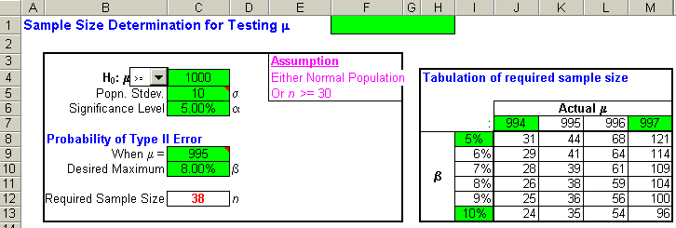
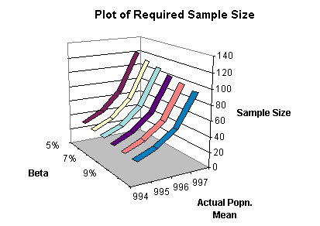
Example 7-9: Using the Template
_{7-<number>}
Note: Similar analysis can be done when testing for a population proportion.
Computing and Plotting Required Sample size.

Slide 81
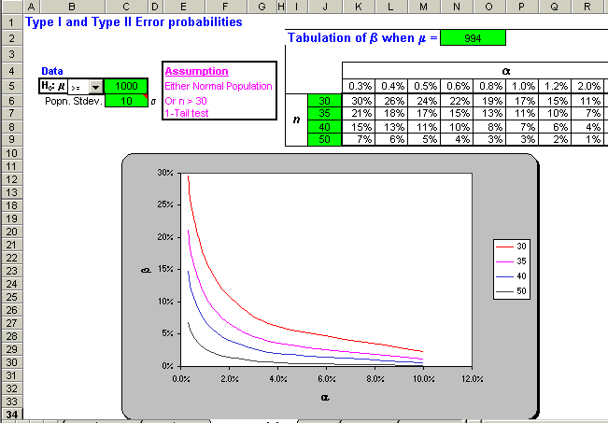
Example 7-10: Using the Template
_{7-<number>}
Plot of β versus α for various n.
Note: Similar analysis can be done when testing for a population proportion.

Slide 82
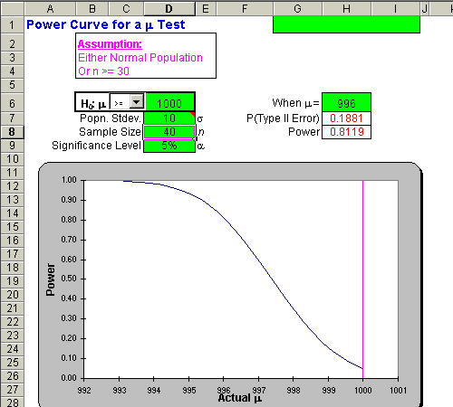
Example 7-10: Using the Template
_{7-<number>}
The Power Curve
Note: Similar analysis can be done when testing for a population proportion.

Slide 83
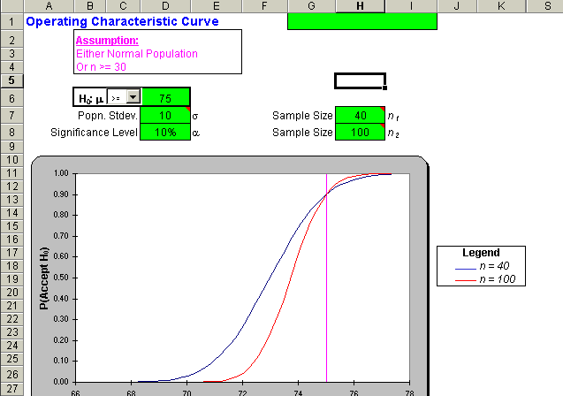
Example 7-10: Using the Template
_{7-<number>}
The Operating Characteristic Curve for
H₀:μ > 75; σ = 10; n = 40; α = 10%
Note: Similar analysis can be done when testing a population proportion.

Slide 84

Example 7-12: Using the Template
_{7-<number>}
H₀:p > 0.52; p₁ = 0.49; α = 10%
Required Sample size = 2233

